Slide 1


Day 24
Math24 (Differential Equations)
Ch 6.1 Definition of Laplace Transformation (Page 309-317)
Elementary Differential Equations and Boundary Value Problems, 10th edition, by William E. Boyce and Richard C. DiPrima, ©2013 by John Wiley & Sons, Inc.

Slide 2
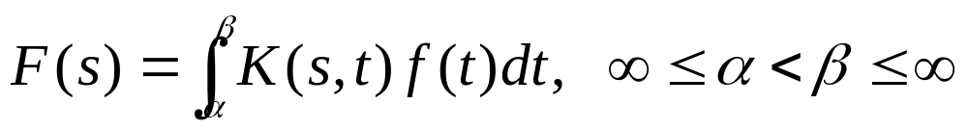
Many practical engineering problems involve mechanical or electrical systems acted upon by discontinuous or impulsive forcing terms.
For such problems the methods described in Chapter 3 are difficult to apply.
In this chapter we use the Laplace transform to convert a problem for an unknown function f into a simpler problem for F, solve for F, and then recover f from its transform F.
Given a known function K(s,t), an integral transform of a function f is a relation of the form

Slide 3
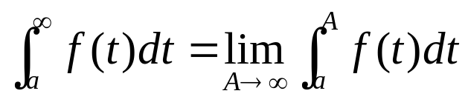
Improper Integrals
The Laplace transform will involve an integral from zero to infinity. Such an integral is a type of improper integral.
An improper integral over an unbounded interval is defined as the limit of an integral over a finite interval
where A is a positive real number.
If the integral from a to A exists for each A > a and if the limit as A → ∞ exists, then the improper integral is said to converge to that limiting value. Otherwise, the integral is said to diverge or fail to exist.

Slide 4
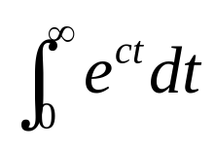
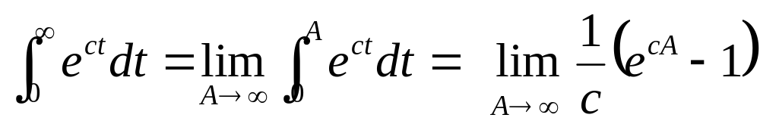
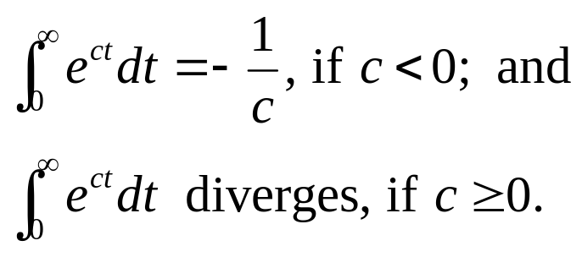
Example 1
Consider the following improper integral.
We can evaluate this integral as follows:
Note that if c = 0, then e^{ct} = 1. Thus the following two cases hold:

Slide 5
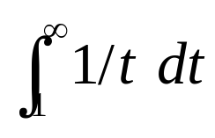
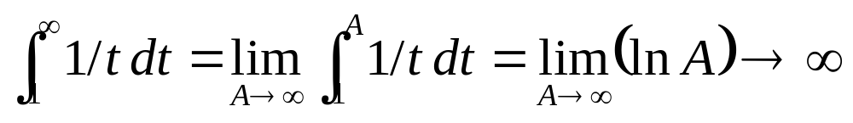
Example 2
Consider the following improper integral.
We can evaluate this integral as follows:
Therefore, the improper integral diverges.

Slide 6
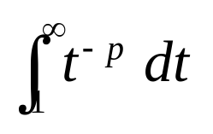
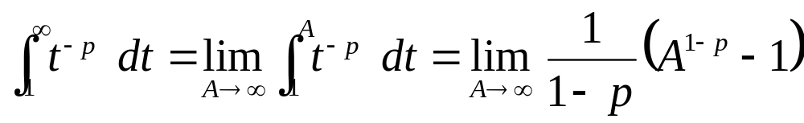
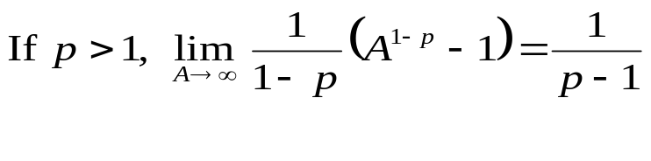
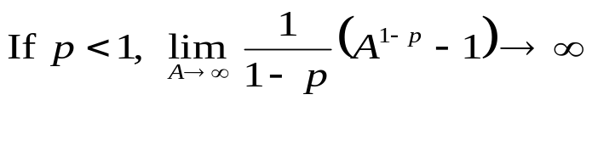
Example 3
Consider the following improper integral.
From Example 2, this integral diverges at p = 1
We can evaluate this integral for p ≠ 1 as follows:
The improper integral diverges at p = 1 and

Slide 7
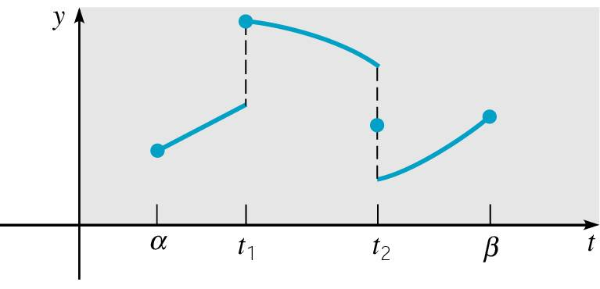
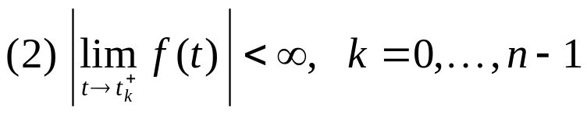
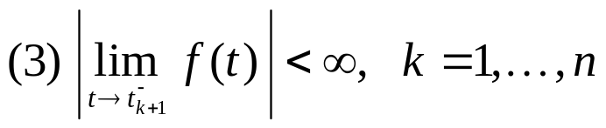
Piecewise Continuous Functions
A function f is piecewise continuous on an interval [a, b] if this interval can be partitioned by a finite number of points
a = t₀ < t₁ < … < t_{n} = b such that
  (1) f is continuous on each (t_{k}, t_{k+1})
In other words, f is piecewise continuous on [a, b] if it is continuous there except for a finite number of jump discontinuities.

Slide 8
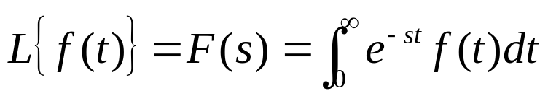
The Laplace Transform
Let f be a function defined for t ≥ 0, and satisfies certain conditions to be named later.
The Laplace Transform of f is defined as an integral transform:
The kernel function is K(s,t) = e^{-st}.
Since solutions of linear differential equations with constant coefficients are based on the exponential function, the Laplace transform is particularly useful for such equations.
Note that the Laplace Transform is defined by an improper integral, and thus must be checked for convergence.
On the next few slides, we review examples of improper integrals and piecewise continuous functions.

Slide 9
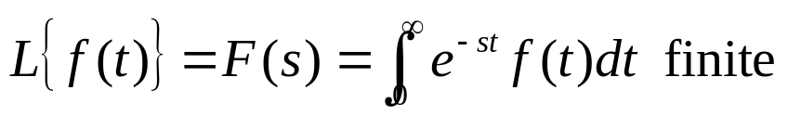
Theorem 6.1.2
Suppose that f is a function for which the following hold:
  (1) f is piecewise continuous on [0, b] for all b > 0.
  (2) | f(t) | ≤ Ke^{at} when t ≥ M, for constants a, K, M, with K, M > 0.
Then the Laplace Transform of f exists for s > a.
Note: A function f that satisfies the conditions specified above is said to to have exponential order as t → ∞.

Slide 10
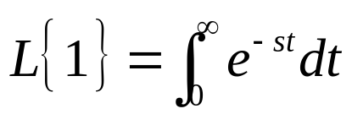
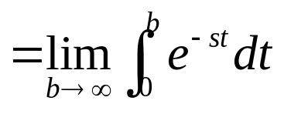
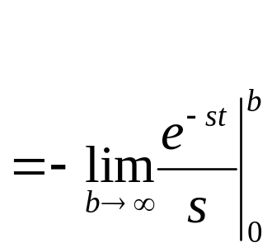
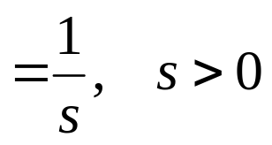
Example 4
Let f (t) = 1 for t ≥ 0. Then the Laplace transform F(s) of f is:

Slide 11
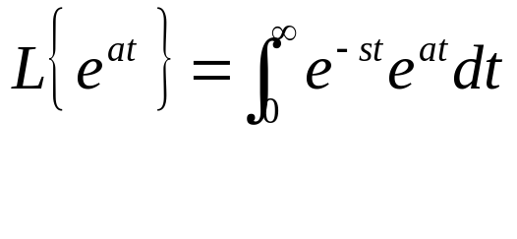
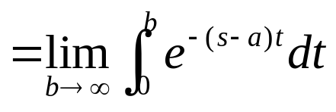
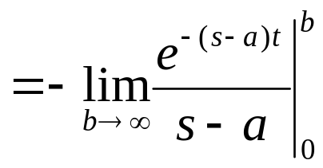
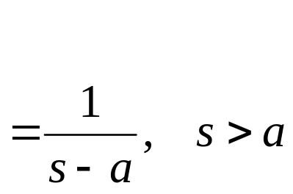
Example 5
Let f (t) = e^{at} for t ≥ 0. Then the Laplace transform F(s) of f is:

Slide 12
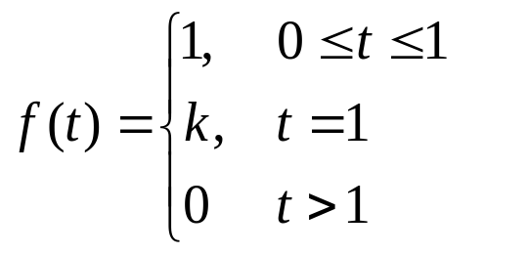
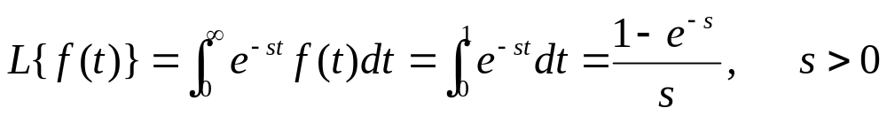
Example 6
Consider the following piecewise-defined function f
where k is a constant. This represents a unit impulse.
Noting that f(t) is piecewisecontinuous, we can compute
  its Laplace transform
Observe that this result does not depend on k, the function value at the point of discontinuity.

Slide 13
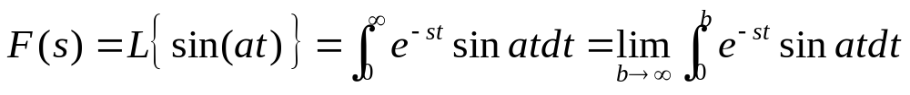
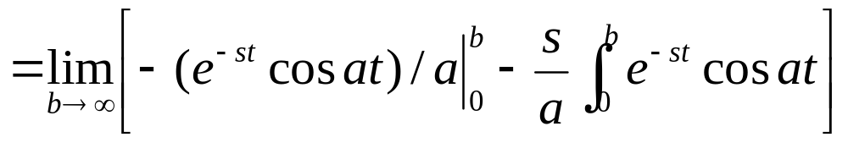
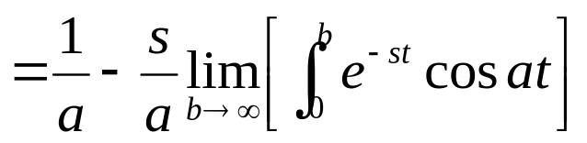
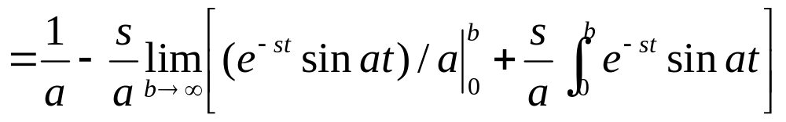
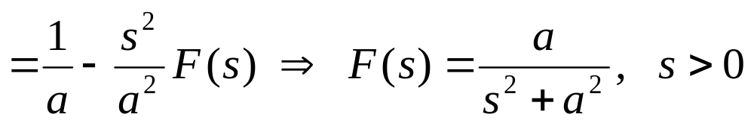
Example 7
Let f (t) = sin(at) for t ≥ 0. Using integration by parts twice, the Laplace transform F(s) of f is found as follows:

Slide 14
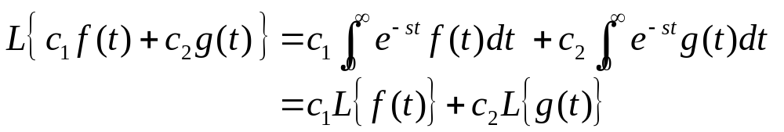
Linearity of the Laplace Transform
Suppose f and g are functions whose Laplace transforms exist for s > a₁ and s > a₂, respectively.
Then, for s greater than the maximum of a₁ and a₂, the Laplace transform of c₁ f (t) + c₂g(t) exists. That is,
with

Slide 15



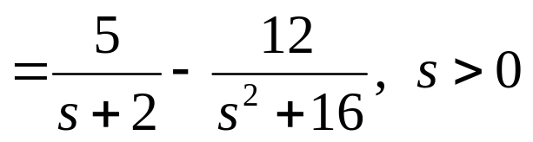
Example 8
Let f (t) = 5e^{-2t} - 3sin(4t) for t ≥ 0.
Then by linearity of the Laplace transform, and using results of previous examples, the Laplace transform F(s) of f is:

